Slide 1

Ashley, Moses, Trevor, Aikerim, Joelle, Norman

Slide 3

The Root Problems
Identify Where Trees are Needed
Awareness of Funding
Inconsistent and Complex Process

Slide 4
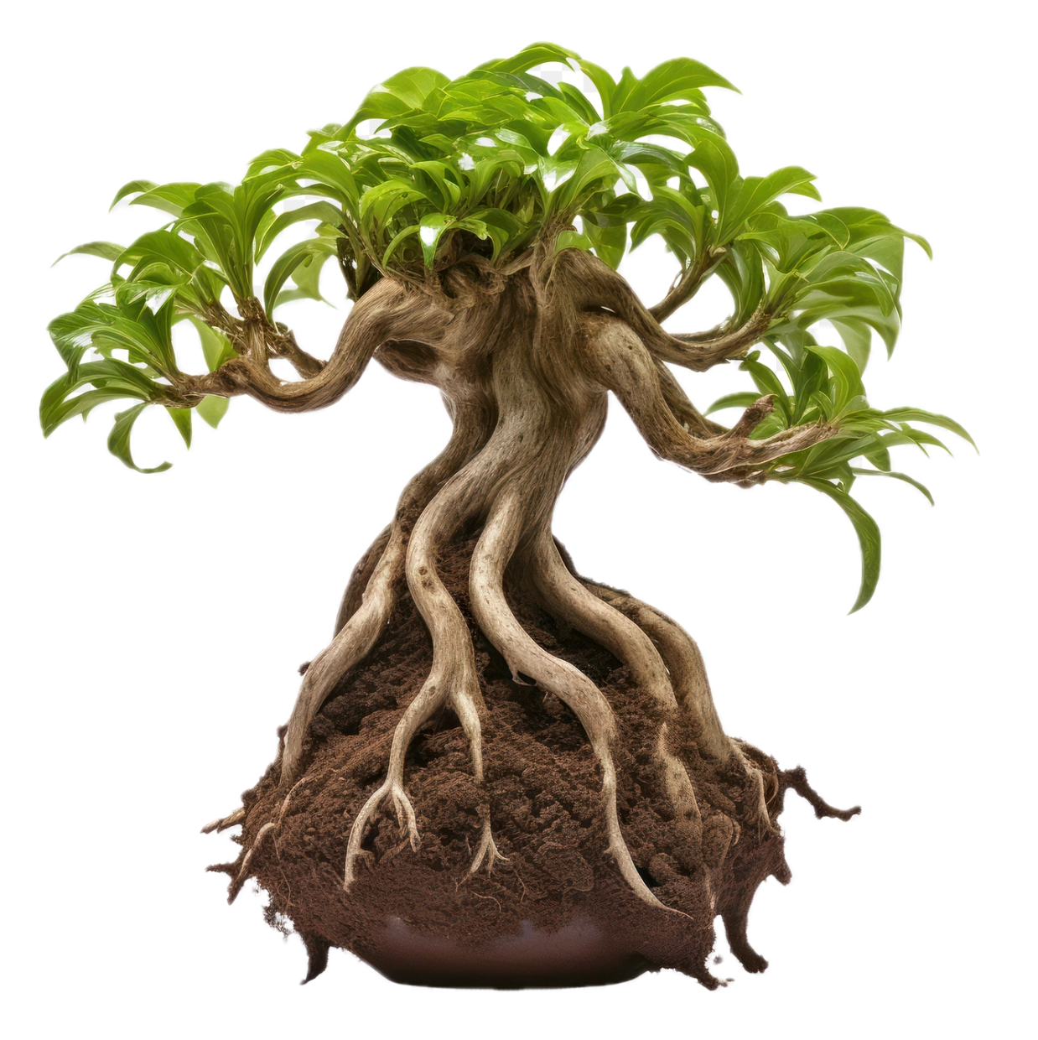

Our Solution
A responsive platform that raises awareness, provides easy-to-understand information on federal tree
planting grants, and guides users
through the grant application
process, ensuring they can
effectively access and utilize
available grants.

Slide 5




